Slide 1
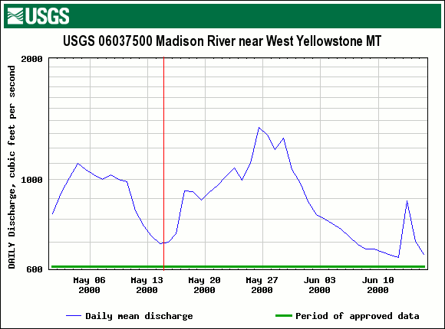
2000 Madison River Discharge

Slide 2
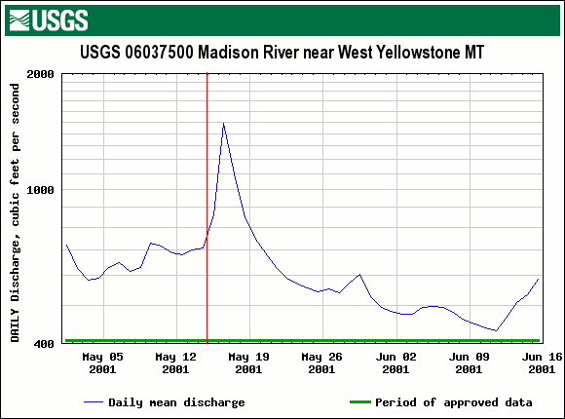
2001 Madison River Discharge

Slide 3
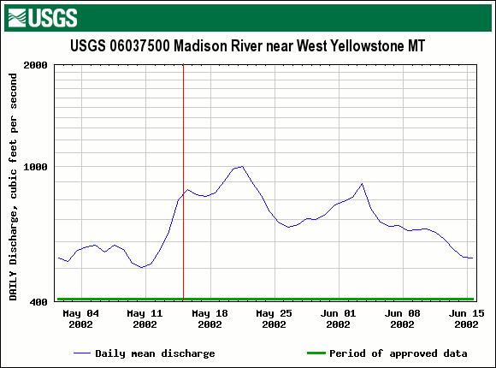
2002 Madison River Discharge

Slide 4
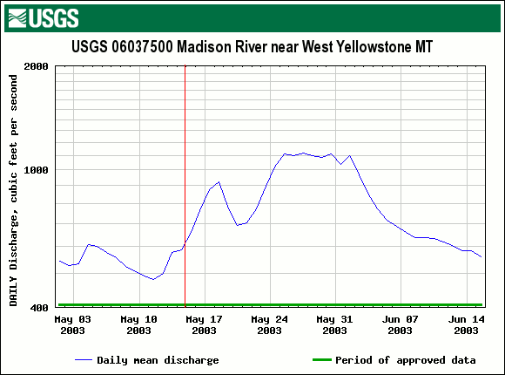
2003 Madison River Discharge

Slide 5
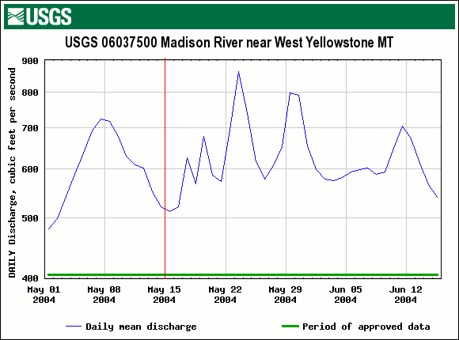
2004 Madison River Discharge

Slide 6
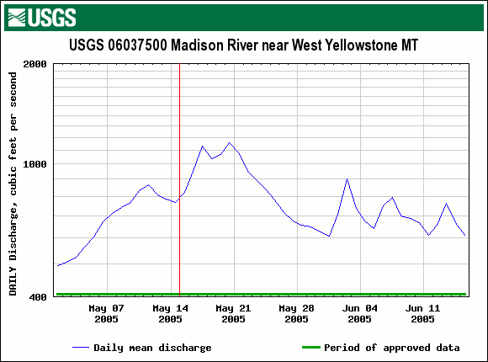
2005 Madison River Discharge

Slide 7
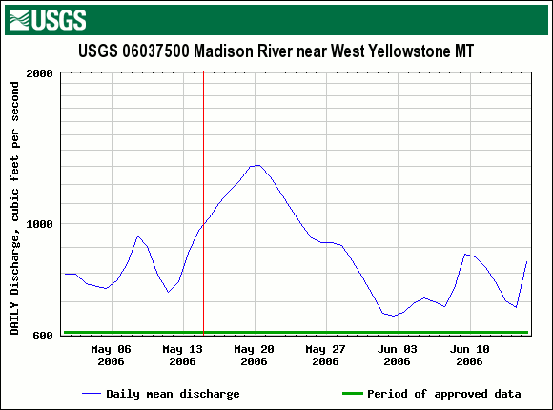
2006 Madison River Discharge

Slide 8
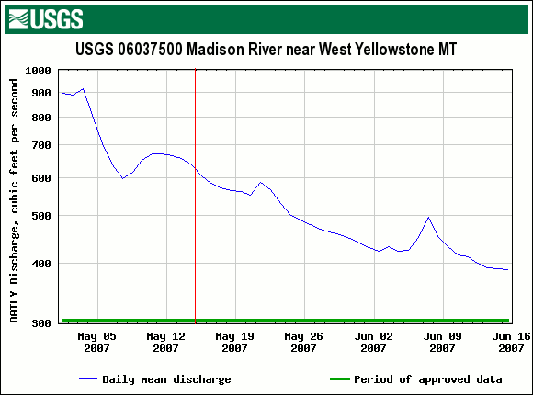
2007 Madison River Discharge

Slide 9
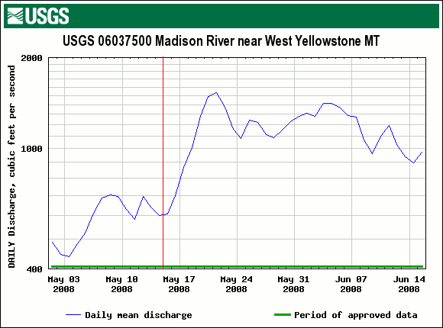
2008 Madison River Discharge

Slide 10
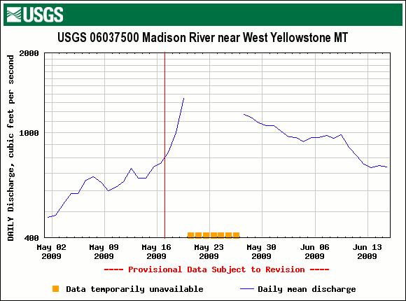
2009 Madison River Discharge

